Slide 1
Welcome
Delaware’s Updated WIOA Plan
William Potter, Dir., DE Workforce Development Board
One-Stop System Convening
May 17, 2018

Slide 2
2018 Convening
W Workforce
I Innovation &
O Opportunity
A Act
Notes:
I plan on showing this when I introduce you…

Slide 3
2018 Convening
WIOA Highlights
Ensures that services are coordinated and complementary so that job seekers acquire skills and credentials that meet employers' needs
Requires that agencies become more aware of other programs that may benefit job seekers and that those resources are shared
Seeks to strengthen and improve the public workforce system.
Helps job seekers acquire industry-recognized credentials for in-demand jobs
Ensures that unemployed and other job seekers have access to high-quality workforce services
Increases individuals with disabilities' access to high quality workforce services
Notes:
So we’re starting with a bit of history to make sure everyone’s on the same page
Key to WIOA is “getting out of our silos” and continuous improvement efforts

Slide 4
2018 Convening
Delaware Workforce Development Board:
Ensures the citizens are provided with occupational training and employment service opportunities to help them achieve sustaining employment.
Communicates with business industry partners to provide them with workers to meet their employment needs.
Has a very active Youth Council that has oversight for programs designed specifically to help Delaware's at-risk and neediest youth prepare for the workforce.
Membership of the Board is composed of business, community and state agency leaders.
Notes:
So we’re starting with a bit of history to make sure everyone’s on the same page
Key to WIOA is “getting out of our silos” and continuous improvement efforts

Slide 5
2018 Convening
Under WIOA, every state has to submit a plan to qualify for a federal grant.
An update must be done every 2 years. 1st plan: 2016-2018
DE just submitted 2018 – 2020 Plan.

Slide 6
2018 Convening
Delaware’s WIOA Plan includes:
Dept. of Labor
Dept. of Health & Social Services
Dept. of Education
Job Corps
Criminal Justice Council
Div. of Libraries
Div. of Small Business
Notes:
Partners also include all of the non-profit organizations that are funded through these agencies
We are a very diverse & complicated system

Slide 8
2018 Convening
And our customers are:
Job Seekers, Learners &
Employers
Key to our plan - How can we provide better customer service?
Notes:
Under WIOA employers & job seekers are our customers
We need to work continuously to improve customer services

Slide 9
2018 Convening
Strategic Mission
The One-Stop system brings together workforce development, educational, and other human resource services in a seamless customer-focused service delivery network that enhances access to the programs' services and improves long-term employment outcomes for individuals receiving assistance.
Its all of you!
Notes:
The mission is what we do – our purpose
Talk about how the strategic vision and goals were developed.
1/21/15 Kick off meeting with Leaders from Partner agencies

Slide 10
2018 Convening
Strategic Vision
Work in alignment and coordination to provide Delaware’s workers with the skills, credentials, and support necessary to secure and advance in employment with family-sustaining wages and to provide local employers with the skilled workers the employers need to succeed in a global economy.
Notes:
The vision is what we are aiming for
There are many improvement initiatives being considered and getting started.
Our focus is to get closer and closer to achieving this vision.

Slide 11
2018 Convening
Implementing WIOA
Initially, 2 tracks were developed:
Strategic Actions
Cultivation of One-Stop Partners and development of an operational vision
Notes:
We’ll review the 4 key goals later
The convening is a great example of Delaware’s strategy for “getting partner staff out of their silos” – we are focused on making sure that all staff are aware of other key services and programs that might benefit a job seeker

Slide 12
2018 Convening
Implementing WIOA
Actions to Align the One-Stop System:
Memorandum of Understanding
WIOA Leadership Team
Centralized Referral Mechanism
One-Stop Teams in each county
Notes:
Just quickly review in your own words
ONE STOP TEAM MEMBERS are tasked with sharing information covered in monthly meetings. This includes information about Partner programs and improvement efforts….The One-Stop Teams will be listed in the program – you might want to mention that.

Slide 13
2018 Convening
WIOA Strategic Goals
Goal #1 – Resource Alignment & Expansion
Goal #2 – Cultural Transformation
Goal #3 – Process Re-Design
Goal #4 – Pathways Evolution
Notes:
Just quickly review in your own words

Slide 14
2018 Convening
Strategic Goal #1
Goal #1 – Resource Alignment & Expansion
Building Partnerships
Leveraging/Aligning Resources
Sustainability Plan
Inter-agency Partners will drive braiding of resources and service strategies
Notes:
Just quickly review in your own words
Partnerships and knowledge of other programs have greatly improved
Leadership Team is actively addressing some large system issues (common intake; documenting referrals among partners, data sharing)

Slide 15
2018 Convening
Strategic Goal #2
Goal #2 – Cultural Transformation
Develop Unified Branding of One-Stop System
Cross-Agency Planning
Staff Training Plan to close any identified skills gaps

Slide 16
2018 Convening
Strategic Goal #3
Goal #3 – Process Re-Design
[mapping & improving the customer flow]
Assessment, Case Management and Referrals to Partner Programs
Unified Business Engagement
Improve Online Resources/Tools for Customers
Interagency Social Media

Slide 17
2018 Convening
Strategic Goal #4
Goal #4 – Pathways Evolution
Ensure access to meaningful skills training, higher education and well paying jobs
Focus on employer’s staffing needs
Provide clear information to job seekers about skills needed & how to learn skills
Notes:
You can say that we have Rachel, from Jobs for the Future, who will be presenting on Pathways, including Adult Pathways concepts.

Slide 18
2018 Convening
Opportunities for Improvement
Inefficient Client Assessment
Inconsistent & Duplicative Business Engagement Processes
Lack of a Cohesive Brand
Better, Clearer Career Pathways
Skills Training Provider Pool
Continuing to Increase Awareness Among Staff
Reporting Referrals Among Partners
Notes:
You might want to comment that the DWDB and the WIOA Leadership Team are currently addressing
Pick the ones you want to talk about (i.e. Pathways)
Just say that I’ll talk a little more about REPORTING REFERRALS AMONG PARTNERS

Slide 19
2018 Convening
WIOA State Plan
“You cannot hope to build a better world without improving the individuals.”
-Marie Curie
Notes:
TURN IT OVER TO ME.

Slide 20
2018 Convening
Reporting Referrals
Among Partners
The WIOA State Plan says that DE will develop a combined workforce development system “through an integrated One-Stop system using a robust referral methodology”

Slide 21
2018 Convening
Reporting Referrals
Among Partners
The Problem:
Staff are making referrals,
but not reporting referrals.
So… our data is not currently
ROBUST

Slide 22
2018 Convening
Reporting Referrals
Among Partners
What is a Partner Referral?
Anytime information about a Partner Program is shared with a job seeker or learner.

Slide 23
2018 Convening
Reporting Referrals
Among Partners
The Solution:
Start reporting referrals that you make.
By email: OneStopReferral@state.de.us
-OR-
Online @ Delaware JobLink
https://doldet.wufoo.com/forms/p3j60fz1m19qpz/
Notes:
You got note pads this morning. The OneStopReferral email address is at the top

Slide 24
2018 Convening
Reporting Referrals
Among Partners
The Solution, part 2:
Online Class registration form:
https://joblink.delaware.gov/ada/r/resources
(under Calendar of Services on the right)
This gets reported as a referral too.

Slide 25
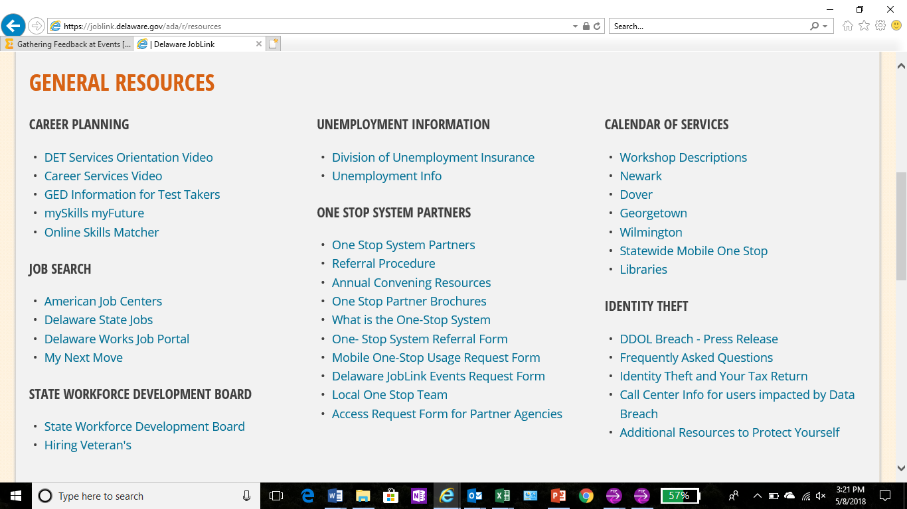

Slide 26
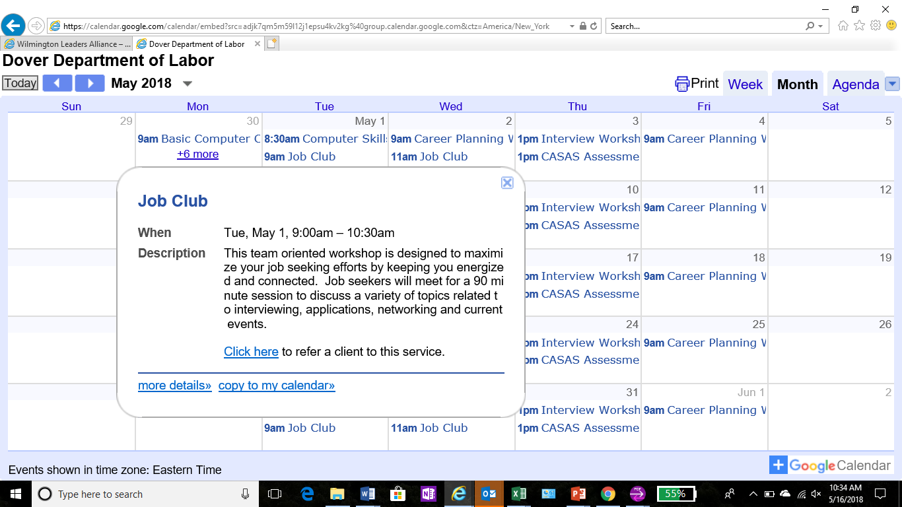

Slide 27
2018 Convening
Reporting Referrals
Among Partners
Let’s show that we are getting
out of our silos and providing information & referrals
for other programs …
Together, we can make that happen.

